Slide 1
IT345 Software Group Project-II Optical Character Recognition (OCR) Guided by- Pinal Shah, Sanket Suthar
Preapred by- Dhaval Barevadiya (16IT005)

Slide 2
What is OCR ?
Optical Character recognition is the mechanical or electronic conversion of images of typed, handwritten or printed text into machine-encoded text, whether from a scanned document, a scene-photo or from subtitle text superimposed on a image.
Later the converted documents can be edited, used or reused in other documents. Thus the documents become editable.

Slide 3
Problem Statement
Many times we need to write text from some hard paper like magazine, newspaper or some images. They could all involve you spending hours retyping manually and correcting typos.
Or you could take a more modern approach and convert any and all of them into a digital format with fully editable text in a matter of minutes.
Using OCR we can capture the image of that page and give that to OCR engine, OCR will convert the text from that image.

Slide 4
Tools and Technologies
Programming language : Python
IDE : Spyder
Convolutional Neural Networks
OpenCV (library for image processing)
Tensorflow (python library for implementing deep learning)
Keras (high level neural network API in python)

Slide 5
Deep Learning and Neural Network
To Implement OCR we are using Convolutional Neural networks which is subpart of deep learning.
To the way a neural network is structured, a relatively straightforward change can make even huge images more manageable. The result is what we call as the CNNs or ConvNets(convolutional neural networks).

Slide 6
Layers in CNN
The first layer in a CNN is always a Convolutional Layer.
The convolution layer comprises of a set of independent filters. Each filter is independently convolved with the image.
Suppose we have 32*32*3 size image and we apply 6 filters then we’ll get output of 6 feature maps of 28*28*1 size after applying a convolution layer.

Slide 7
Layers in CNN (contd.)
After each conv. layer, it is convention to apply a nonlinear layer (or activation layer) immediately afterward.
The purpose of ReLU layer is to introduce nonlinearity to a system that basically has just been computing linear operations during the conv. layers.
In the past, nonlinear functions like tanh and sigmoid were used, but researchers found out that ReLU layers work far better.

Slide 8
Layers in CNN (contd.)
Pooling Layer is also called as downsampling layer.
This basically takes a filter (normally of size 2x2) and a stride of the same length.
Pooling layer serves two main purposes. The first is that the amount of parameters or weights is reduced by 75%, thus lessening the computation cost. The second is that it will control overfitting.
A symptom of overfitting is having a model that gets 100% or 99% on the training set, but only 50% on the test data.

Slide 9
Layers in CNN (contd.)
Fully Connected Layer (FC) basically takes an input volume (whatever the output is of the conv or ReLU or pool layer preceding it) and outputs an N dimensional vector where N is the number of classes that the program has to choose from.
For example, if you wanted a digit classification program, N would be 10 since there are 10 digits.
Here we are using softmax approach to represent output.

Slide 10
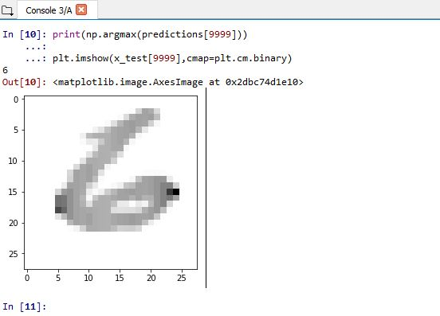
Snapshot of Demo model

Slide 11
Steps to complete project
1. Pre-processing: grayscale conversion, noise removal(filteration) etc.
2. Feature extraction
3. Fetching the extracted feature(data) to Neural Network and training it to recognize character.

Slide 12
Future Enhancement
This OCR engine can be used to make some applications like vehicle number plate recognition.
Training and recognition speeds can be increased greater and greater by making it more user-friendly.
Model accuracy can be increased with more dataset and training epochs.

Slide 13
References
https://adeshpande3.github.io/adeshpande3.github.io/A-Beginner's-Guide-To-Understanding-Convolutional-Neural-Networks/
https://pythonprogramming.net/
https://www.coursera.org/learn/convolutional-neural-networks/
https://courses.cognitiveclass.ai/courses/course-v1:CognitiveClass+ML0120ENv2+2018/info/
https://neuralnetworksanddeeplearning.com/chap1.html
https://datascience.stackexchange.com/
https://stackoverflow.com/

Slide 14
Thank You

